Slide 1
<bootstrap>
vs
<foundation>
!-- who owns the future? --

Slide 2
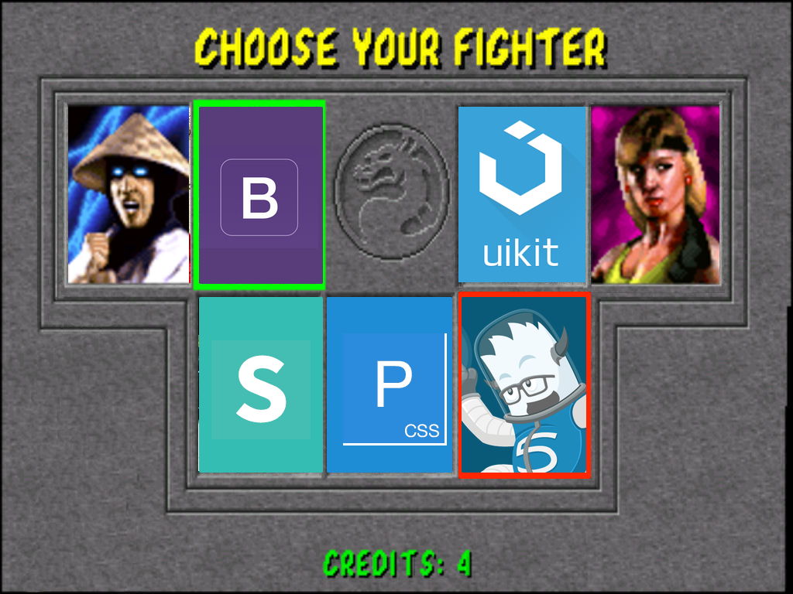

Slide 3

Round 1
What and who

Slide 4


bootstrap
foundation
Mark Otto
@mdo
close-knit team
of product designers
Jacob Thornton
@fat

Slide 5
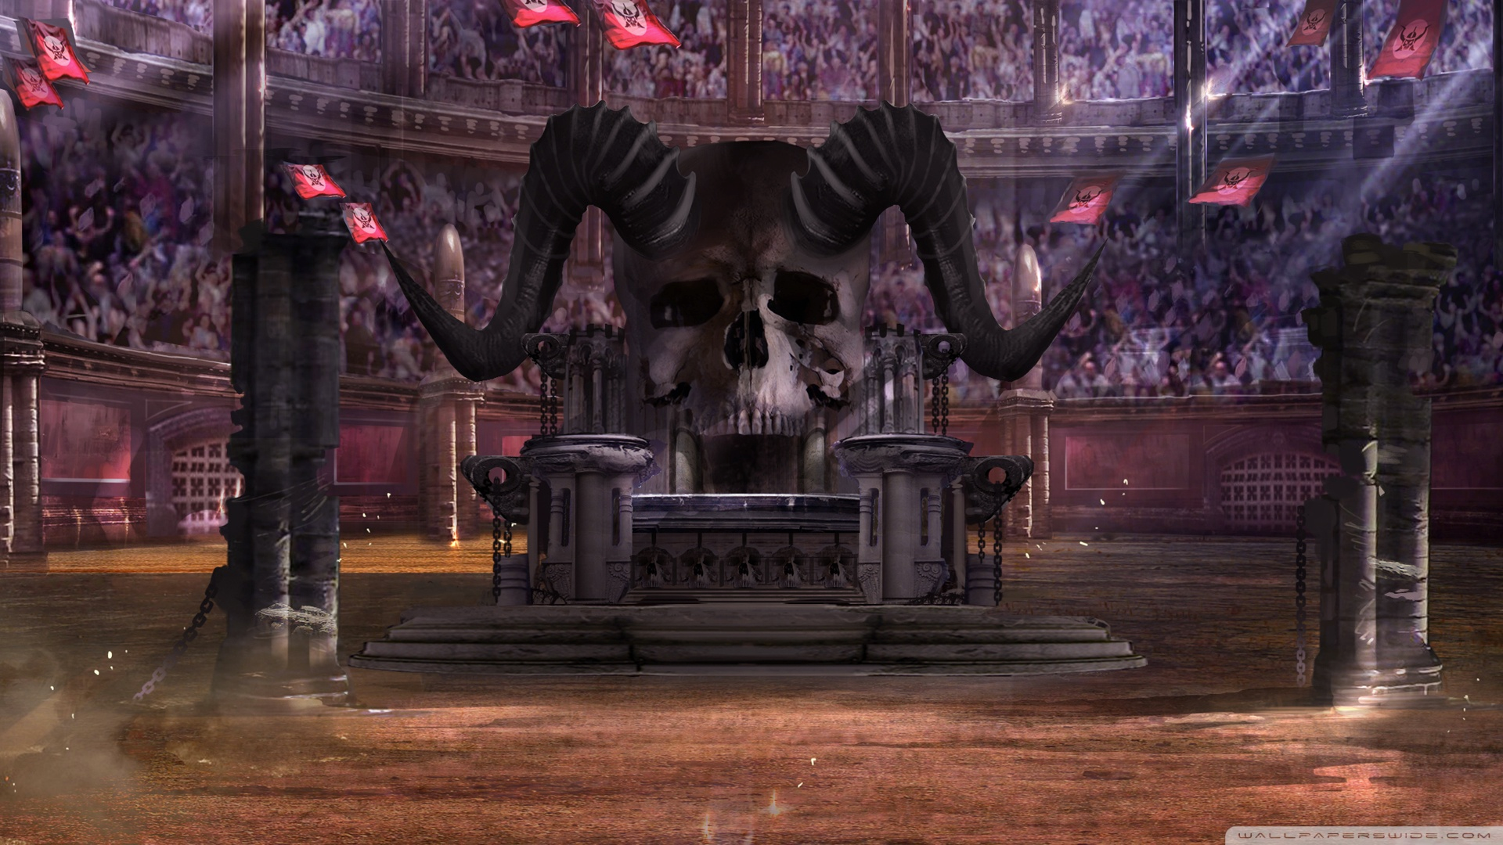
Round 2
Community/ Support

Slide 6




bootstrap
foundation
80k+
stars
20k+
stars
135,449
results
51,544
results

Slide 7

Round 3
CSS

Slide 8



bootstrap
foundation
203 KB
3343 Selectors
4088 Declarations
unCSS
120 KB
2561 Selectors
2725 Declarations
EM based
Base classes
Visibility classes
PX based

Slide 9

Round 4
Grids and Responsiveness

Slide 10
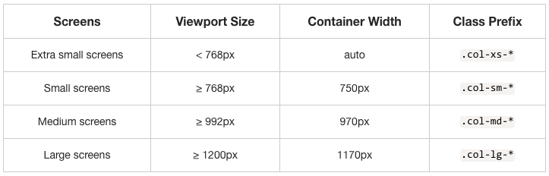
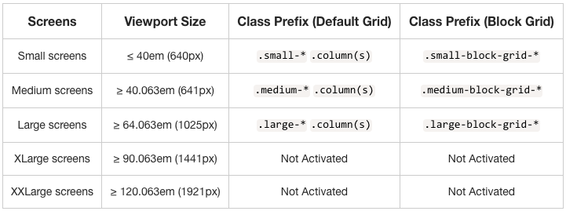
bootstrap
foundation
+Interchange

Slide 11
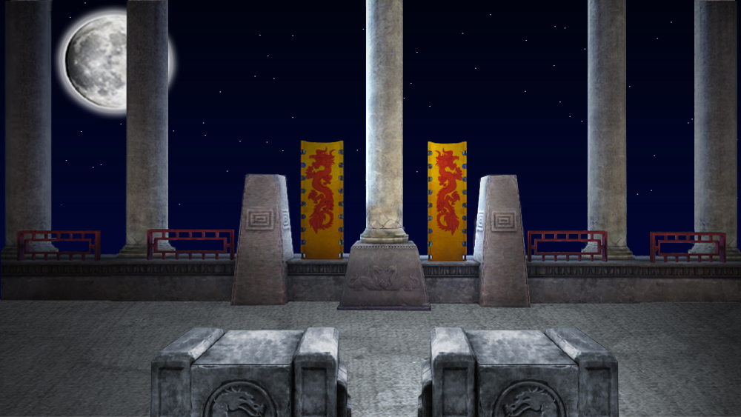
Round 5
UI and Widgets

Slide 12
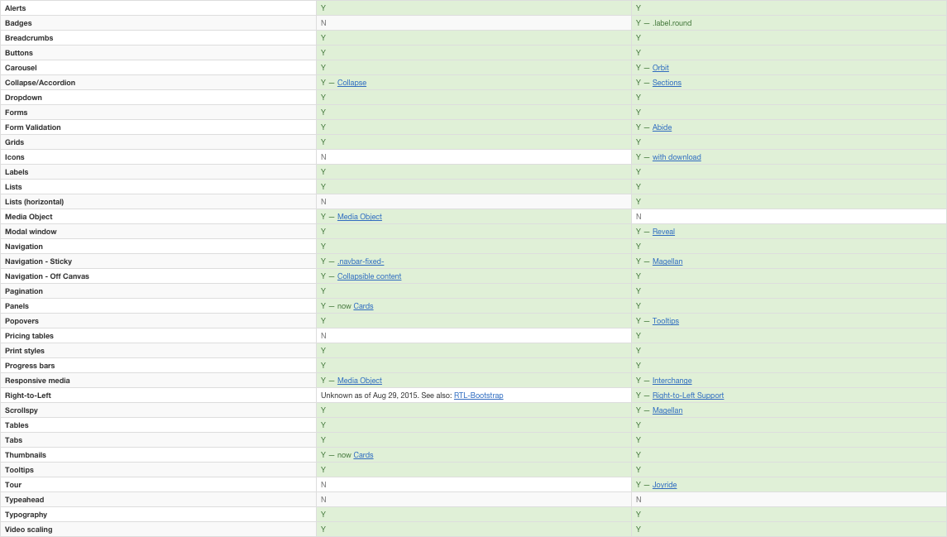
bootstrap
foundation

Slide 13
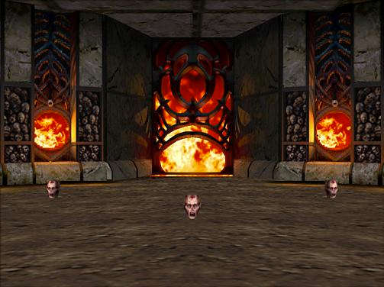
Round 6
JS

Slide 14


bootstrap
foundation

Slide 15

Round 7
Combatibility browser support

Slide 16

bootstrap
foundation
Modern browsers (IE9 +)

Slide 17
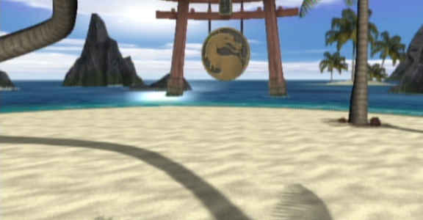
Round 8
Showcase

Slide 18
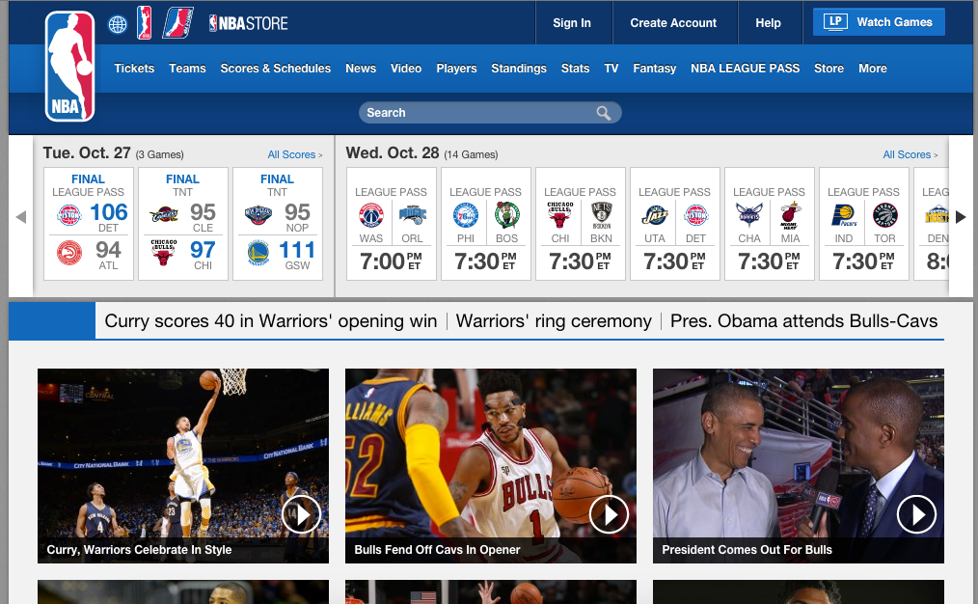
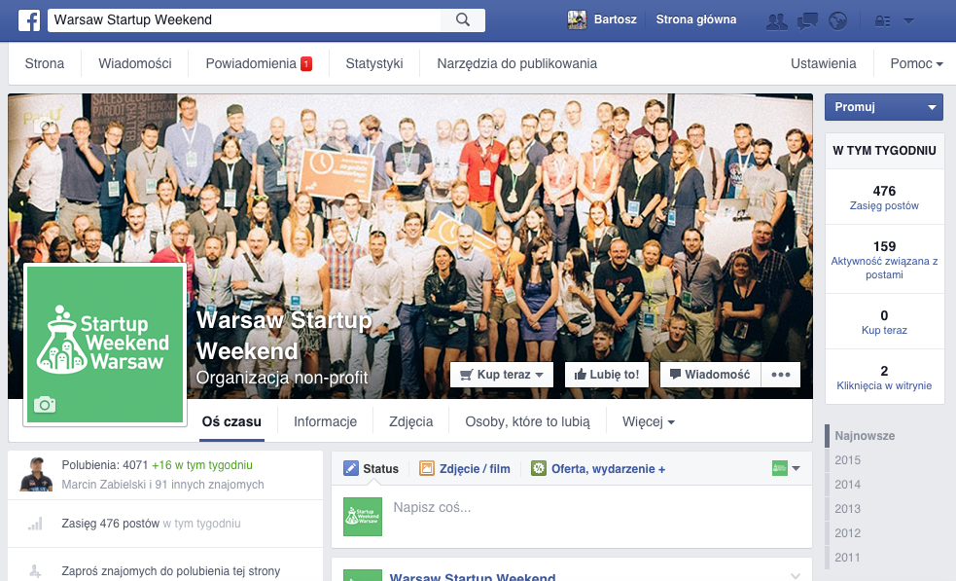
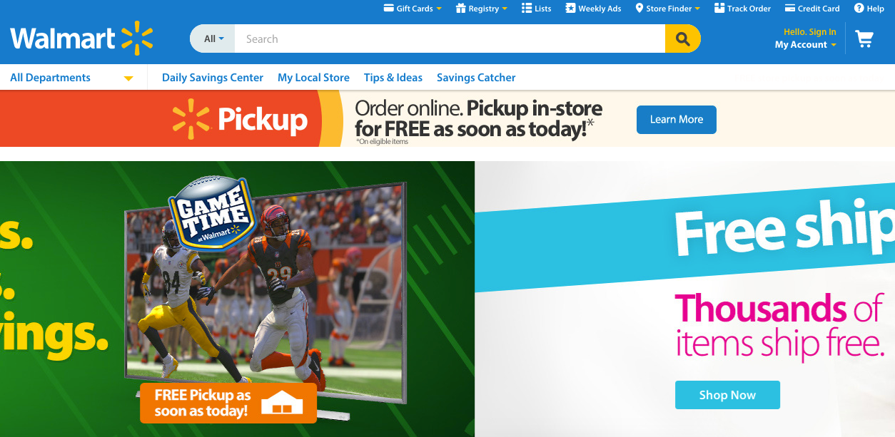


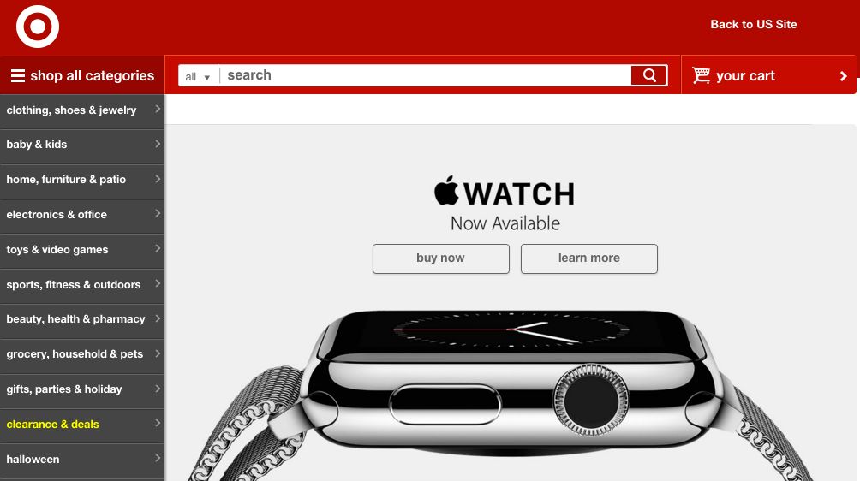
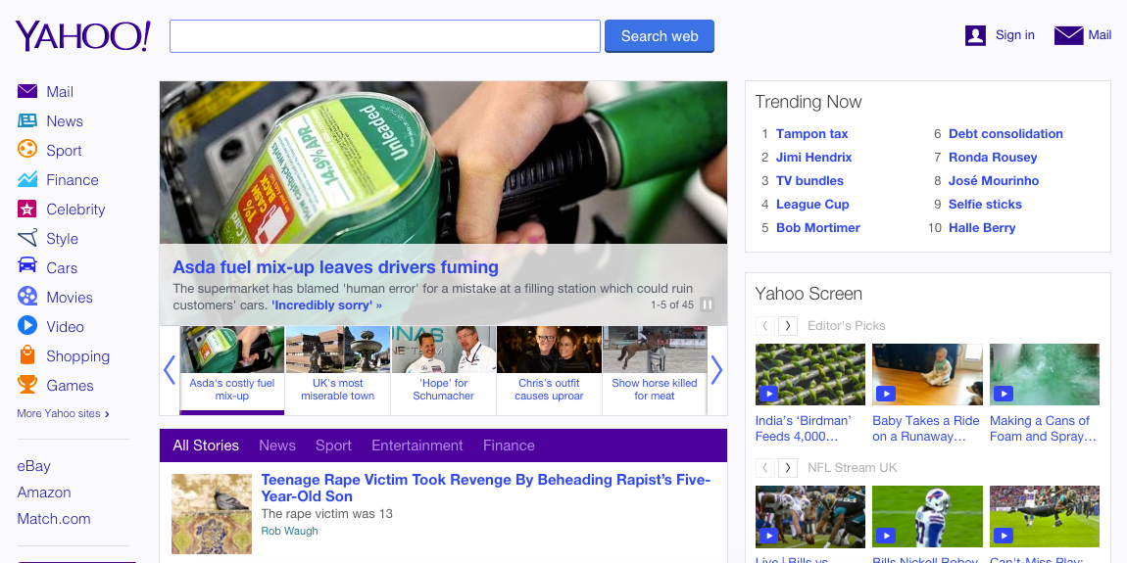

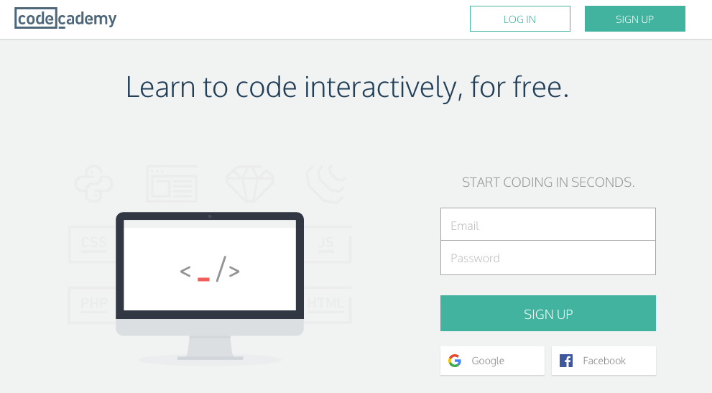
bootstrap
foundation

Slide 19
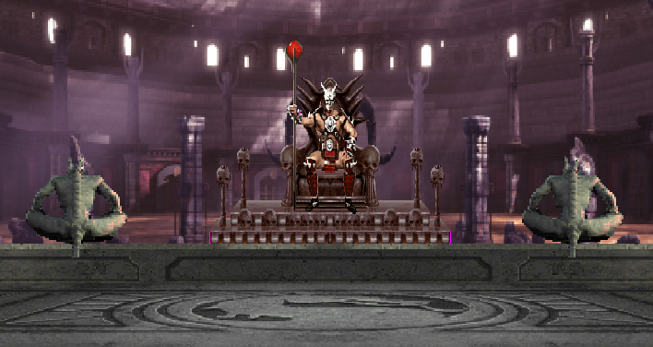
Round 9
Future

Slide 20
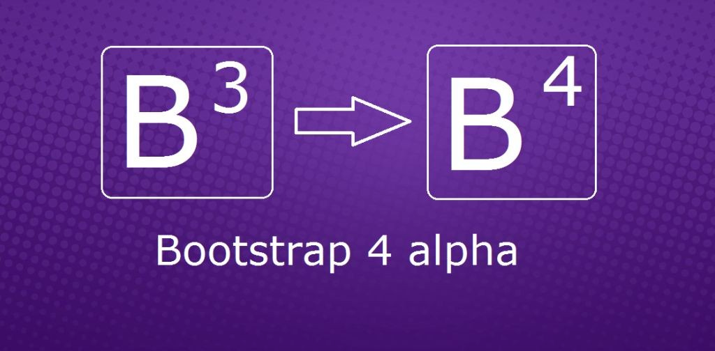
bootstrap
foundation
HERE Full Accessibility
Flexbox grid system
UnCSS
Slimming Down – Some Components May be Deprecated
Motion UI
Foundation JavaScript Re-Written from Scratch

Slide 21
<bootstrap>
vs
<foundation>
YOU DECIDE!!!

